Slide 1
CAMERA TRANSITIONS Personal Research – Project II
Roger Pérez Romera
CITM UPC Terrassa

Slide 2

Theory: - What is a transition? - Types of transitions - Use of transitions Code: - Code structure
TODOS: - Six easy steps to create a new transition
Scott Pilgrim vs The World

Slide 3
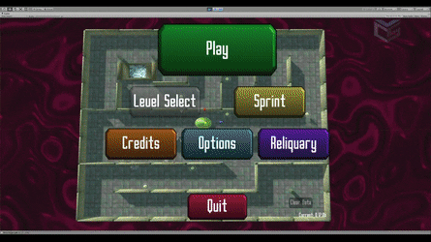

Theory – What is a transition?
Effect between a scene and the next one.
Create and produce an effect to the spectator.
Films, videogames, series…
Cinematic moments vs. menus and UI.
Star Wars
Sky Labyrinth

Slide 4
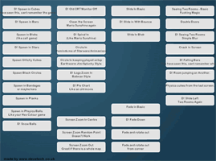
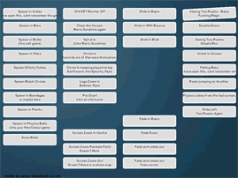
Theory - Types of transitions
Fade:
Slow
Tension
Importance
Cross - Fade:
Faster
Simple
Non-Aggressive

Slide 5
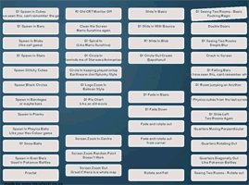
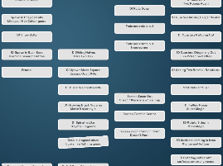
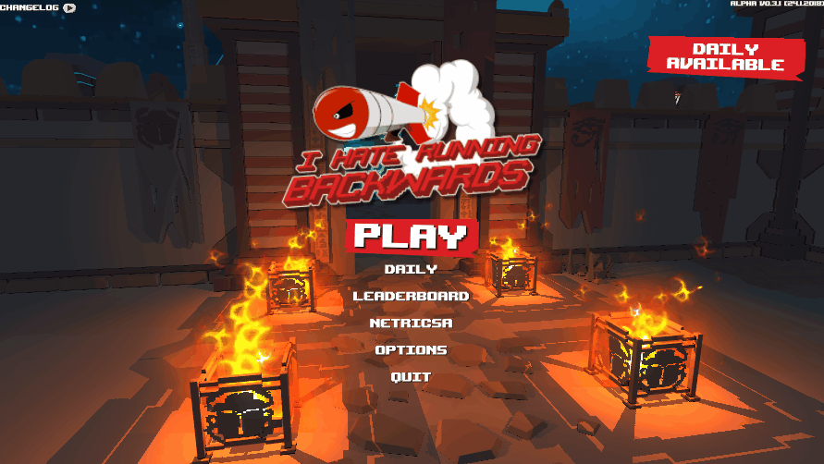
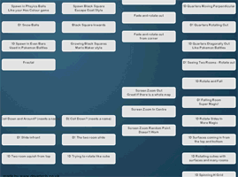
Theory - Types of transitions
Wipe:
Freedom
Emotional charge
Pan and Zoom:
Powerful
Dynamism
Action
I Hate Running Backwards

Slide 6
Theory - Use of transitions
The transitions you choose are important!
But for the game… transitions will give us time to:
Load a scene or level.
Keep the player immersed.
So we will do the change of scene during the transition.
Use the next links to get creative on your scenes transitions:
http://www.davetech.co.uk/screentransitions
https://www.youtube.com/watch?v=fKgvno6k-og

Slide 7
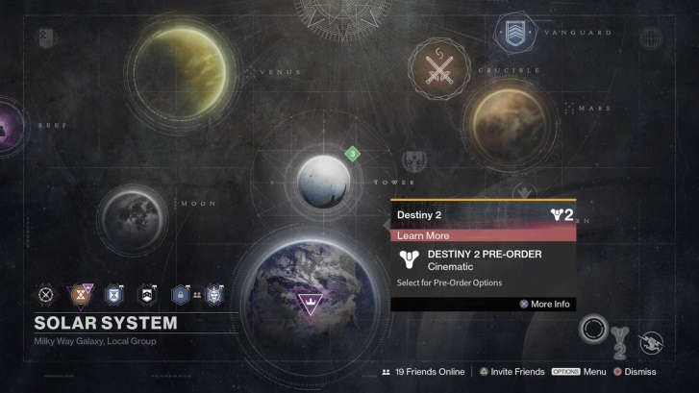

Code - Structure
Simple.
1 Module for the transitions(h/cpp).
Two scenes: Scene 1 and Scene 2.

Slide 8
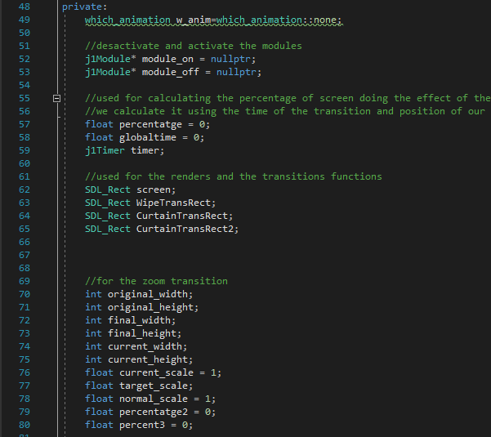
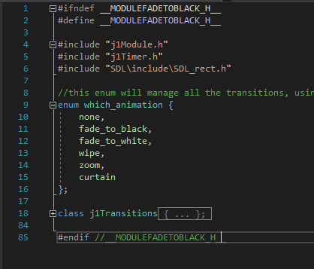
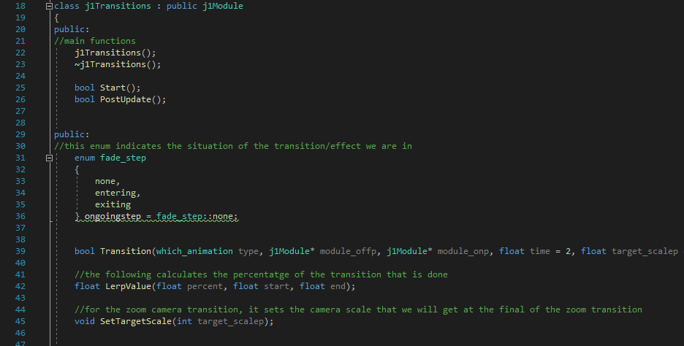
Code – Structure: Transitions.h
Enum which_animation: five types of
transitions.
class j1Transitions:
Main elements
Function Transition
Initialize variables for Transitions.cpp.

Slide 9
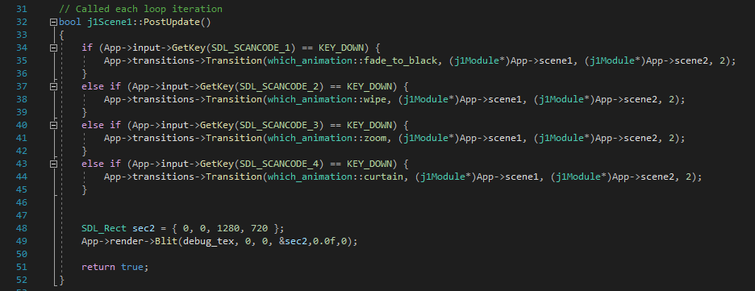
Code – Structure: Transitions.cpp and scenes
Two switch in the postUpdate:
One for the fade step
One for the blit of each transition.
Scene1 and Scene2:
Will call the function Transition given an input.
We must give: type of transition, scene to go off, next scene and time.

Slide 10
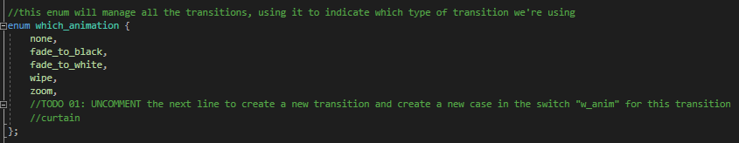
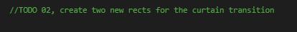
TODOS – Todo 01 and Todo 02
The first step is just create a new type of transition.
The second Todo just requires create two new rects that we will use in the next transition.

Slide 11
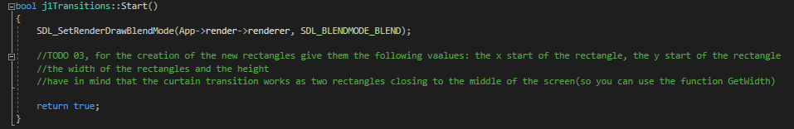
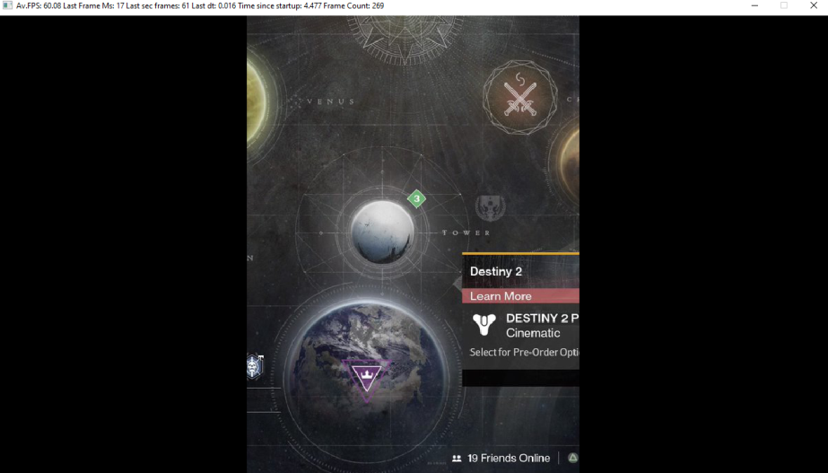
TODOS – Todo 03
To create the two rects required, we need to give them their values.
Each rect will cover half of the screen.
They will start from the two laterals of the screen.

Slide 12
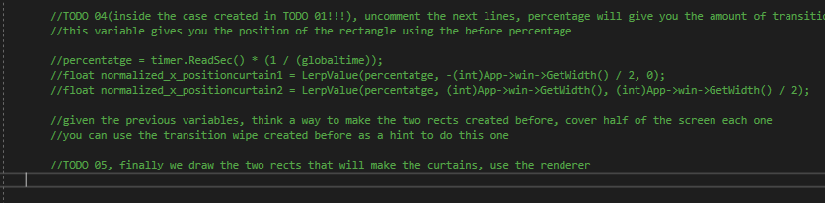
TODOS – Todo 04 and Todo 05
This Todo is more complicated, you already have two variables that will help you, uncomment them.
You must create inside the case and in the step “entering” the way the rects will be drawn.
For the fifth Todo you just have to draw the two functions:
SDL_SetRenderDrawColor
SDL_RenderFillRect

Slide 13
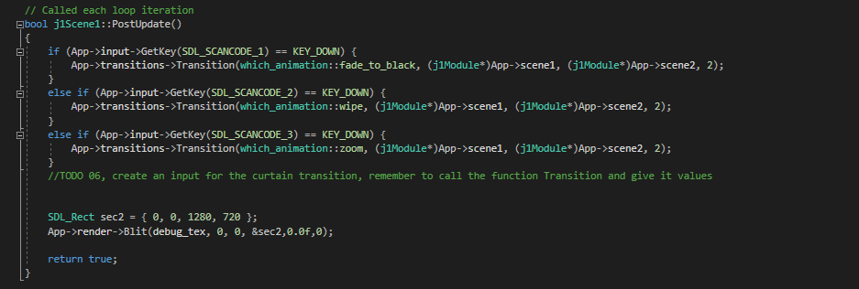
TODOS – Todo 06
This last Todo is a gift.
Create and input to call the Transition function in Scene01.
Remember to give all the needed variables!

